Slide 1

Impact of LSD on behavioural flexibility
Art by
Gizem Vural
Petra Bachanova, Matt Ciolkowski, Anna Lyndaker, Johnathan Rodgers, Mizuki Tojo
Notes:
CONTEXT DOUCETTE LAB IND103

Slide 2




Outline
Background
Limitations &
Next steps
Results
Workflow
Summary
Acknowledgements

Slide 3
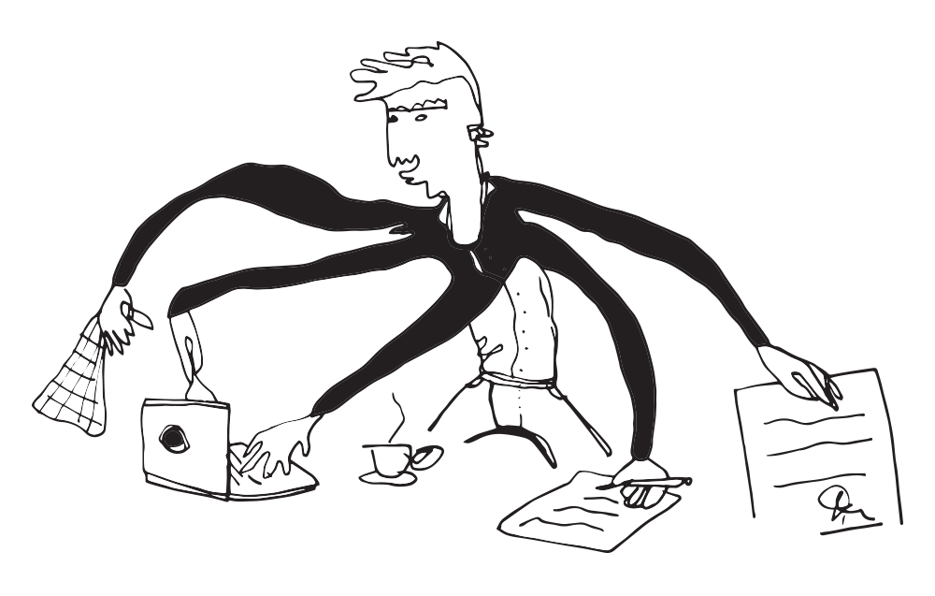
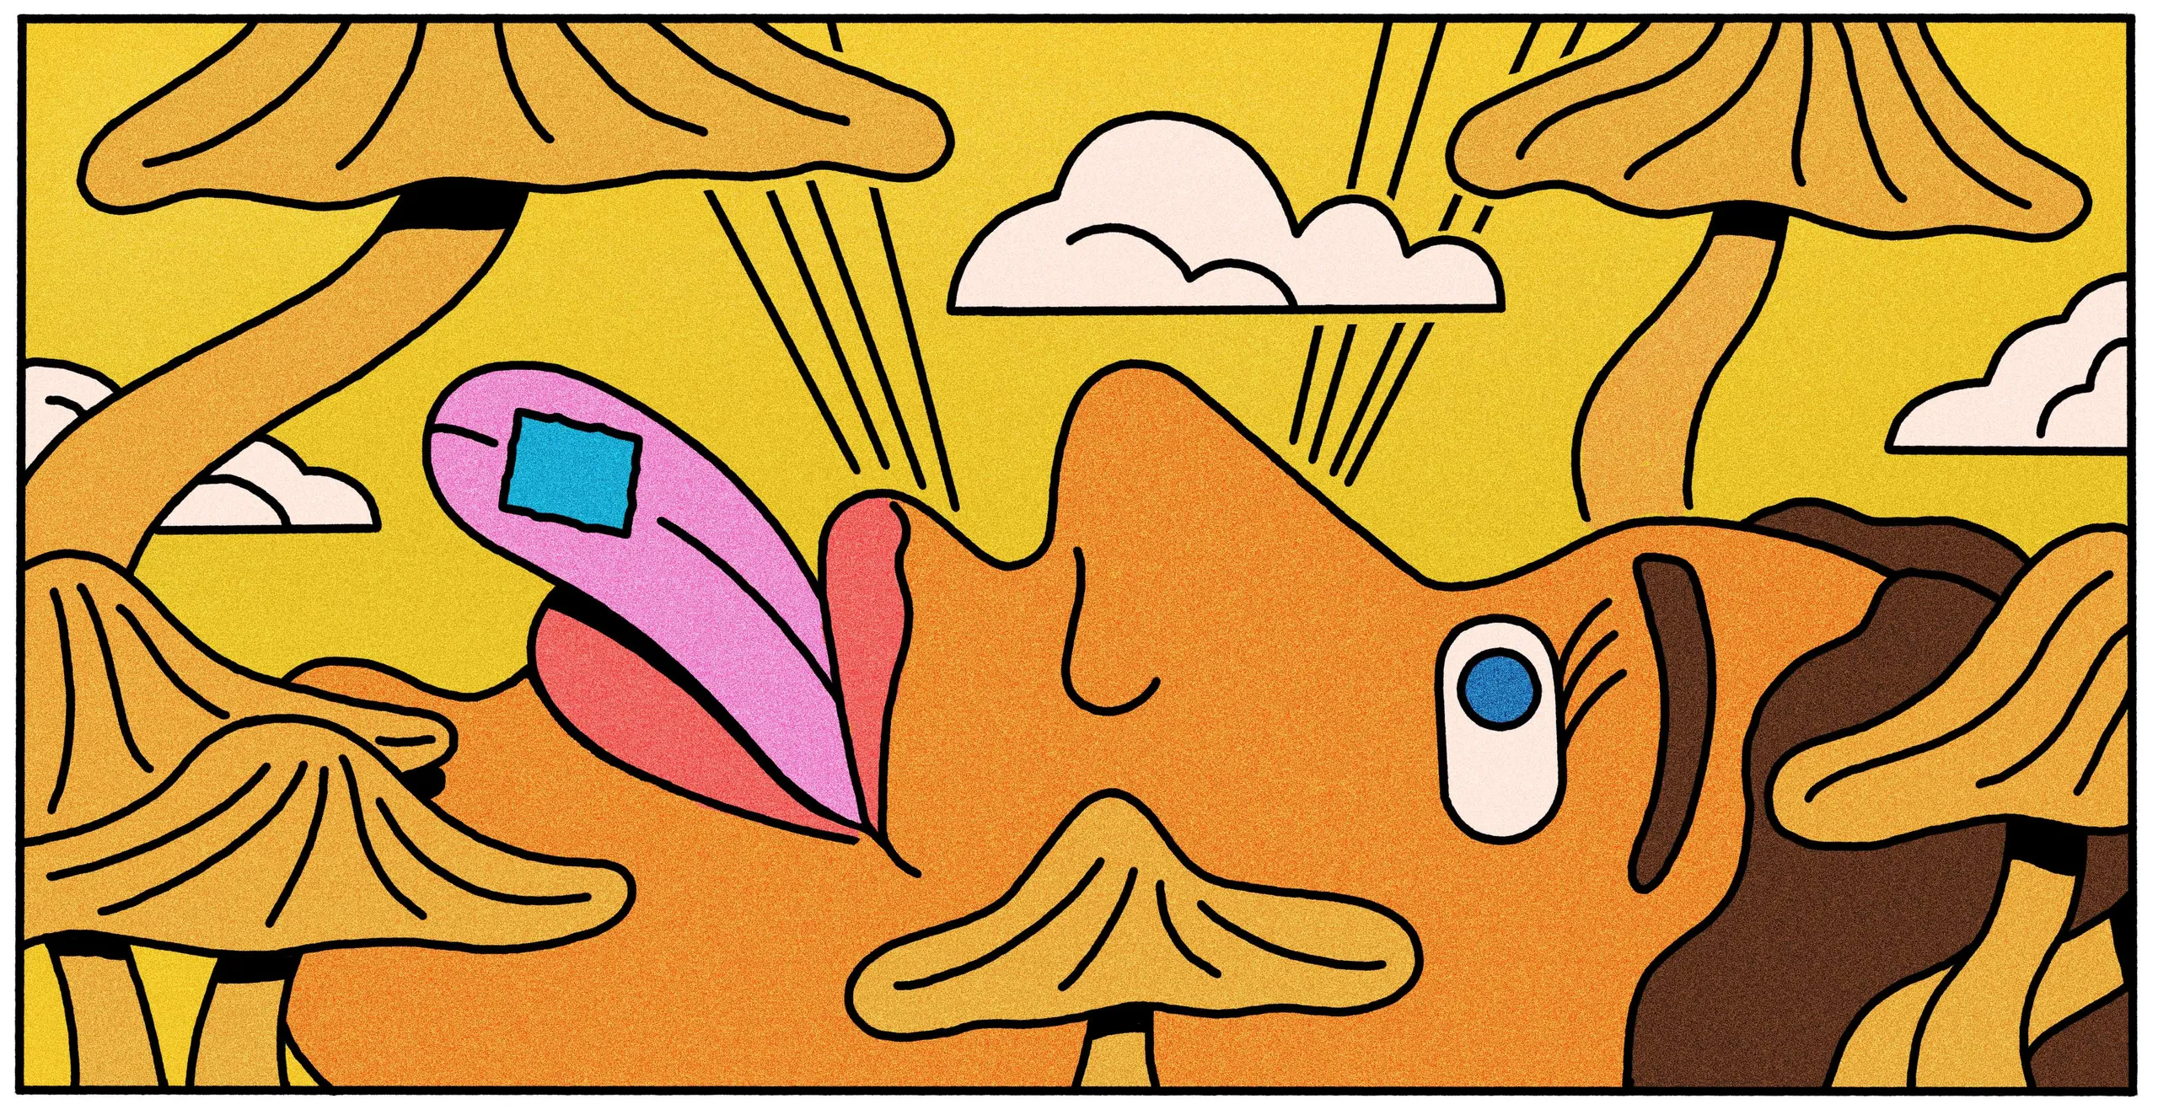

Behavioural flexibility
Psychedelics
Cognitive flexibility as a mechanism of action of psychedelics
Impairments in
Shown promise in
MDD, SUD, PTSD
Notes:
Ability to maintain multiple concepts simultaneously and shift internal attention between them.
Ability to appropriately adapt to changing environment, switching between different behaviours depending on the context.
These are closely intertwined and sometimes used interchangeably.
Impairments in cognitive/behavioural flexibility are a feature of various mental health disorders, including major depression disorder and substance use disorder.
Improving cognitive flexibility to break out of patterns of detrimental behaviour is a plausible mechanism of action of psychedelic treatment

Slide 4
Does LSD impact behavioural flexibility in healthy rats?
Notes:
Ability to maintain multiple concepts simultaneously and shift internal attention between them.
Ability to appropriately adapt to changing environment, switching between different behaviours depending on the context.
These are closely intertwined and sometimes used interchangeably.
Impairments in cognitive/behavioural flexibility are a feature of various mental health disorders, including major depression disorder and substance use disorder.
Improving cognitive flexibility to break out of patterns of detrimental behaviour is a plausible mechanism of action of psychedelic treatment

Slide 5
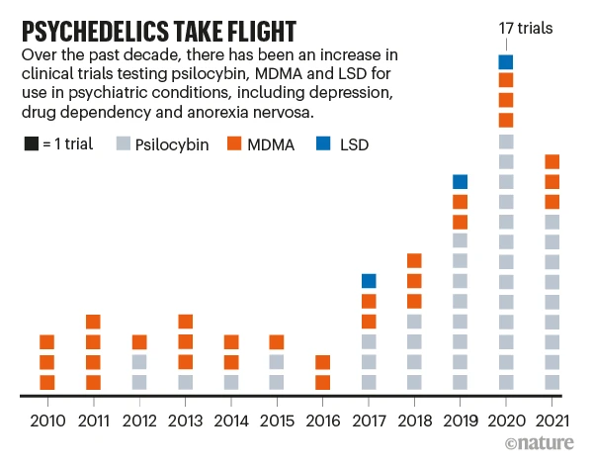

Slide 6
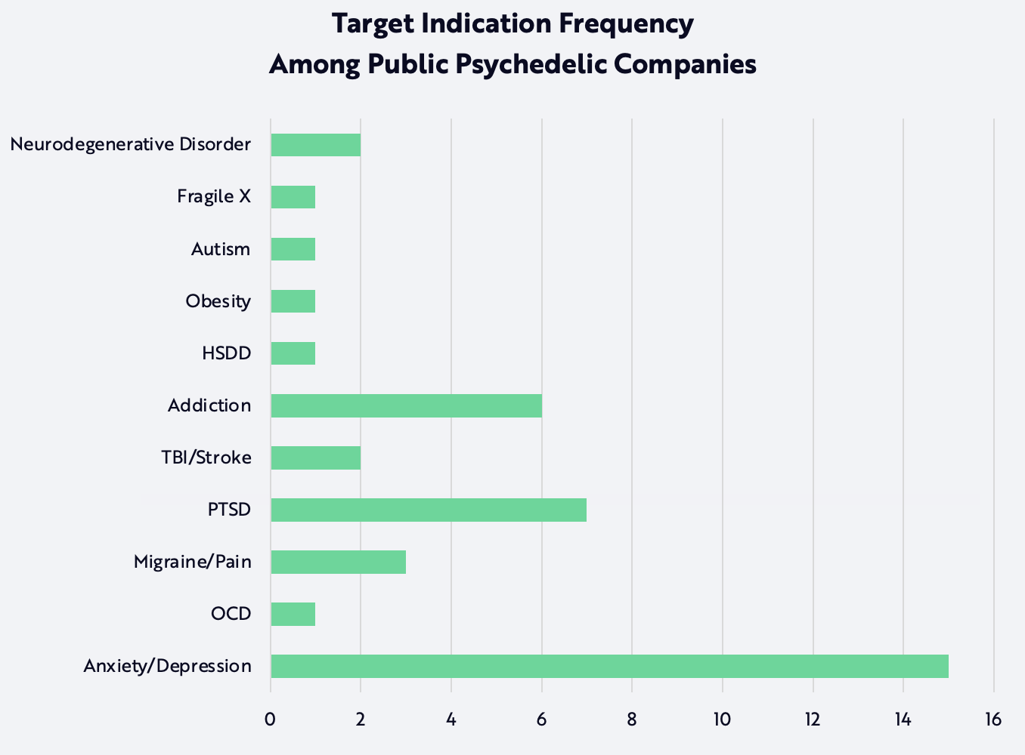
ARK Investment Management LLC, 2022
Notes:
HSDD = Hypoactive sexual desire disorder
Doucette lab interests

Slide 7
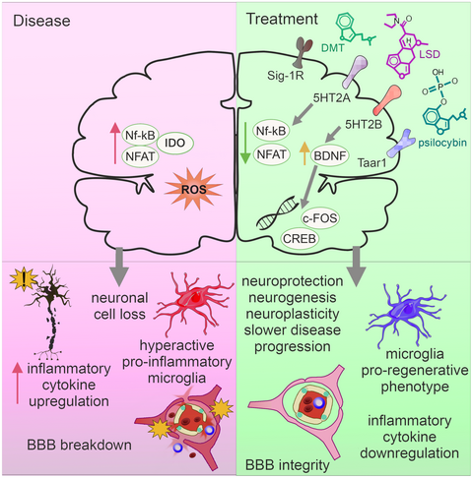
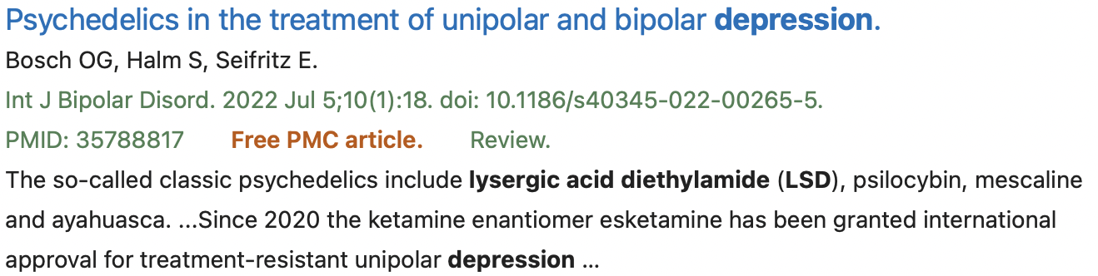
Background: why would you want to take LSD?
Synaptogenesis
Cognitive flexibility

Slide 8
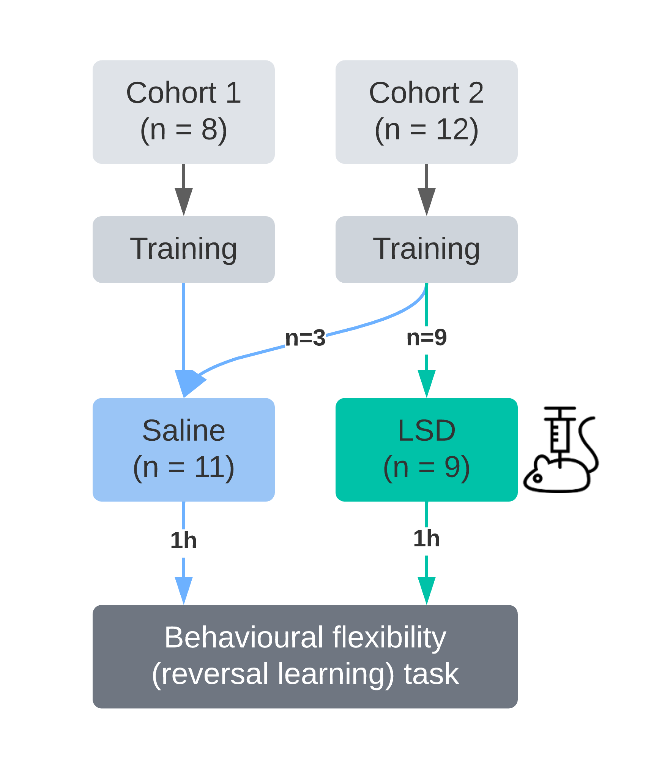



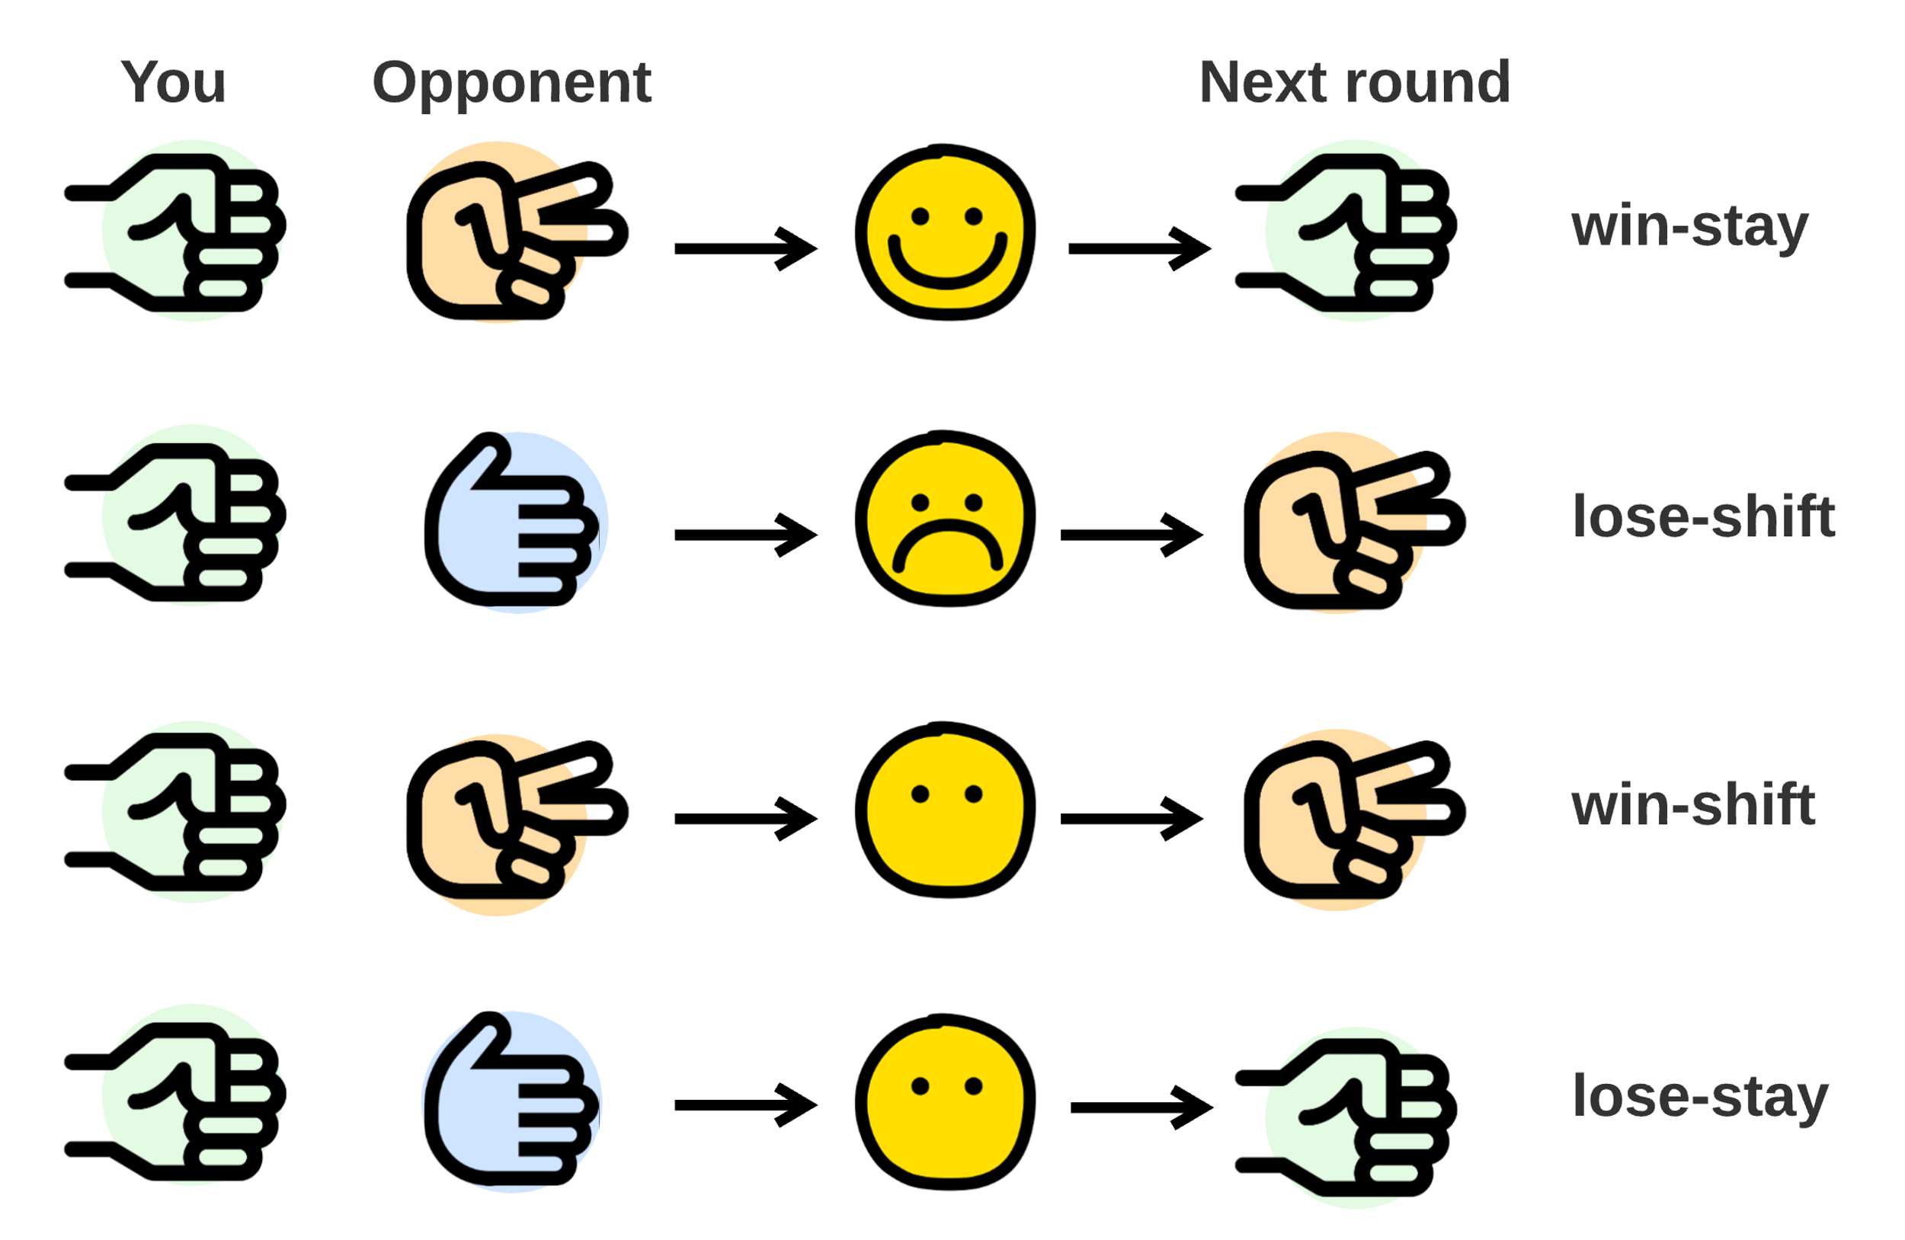
Workflow
2 cohorts of healthy rats. Cohort 1 run prior to, cohort 2 during IND103.
Behavioural training on a set of 2 levers.
A correct trial
Intraperitoneal injection with Saline or 0.2mg/kg LSD.
Reversal Learning
Multiple blocks:
B1 = known rule (right, left)
B2 = reversed (left, right)
Rule switches each subsequent block.
To progress to the next block, 7/10 trials correct (rolling window of 10)
Block 1
Block 2
…
Block n
❌ ❌ ❌ ✔️ ❌ ✔️ ✔️ ✔️ ✔️ ❌ ✔️ ✔️
Notes:
Cohort 1 – no saline injections, Cohort 2 controls – with saline injections

Slide 9


Relevant questions & defining features
Does LSD alter ‘short-term’ flexibility i.e., ease of learning the reversal of a task?
What happens on the day of reversal?
Does LSD alter ‘long-term’ flexibility i.e., ease of switching once reversal was achieved?
Metrics/features
Number of reversals
Number of trials taken to achieve reversal (only Q1 & 2)
Accuracy = correct trials/all trials
Streak, proportion of persistent zeros
Strategies: win-stay, lose-shift, lost-stay, win-shift
treatment
reversal
treatment
reversal
treatment
reversal
reversal + 3 days

Slide 10
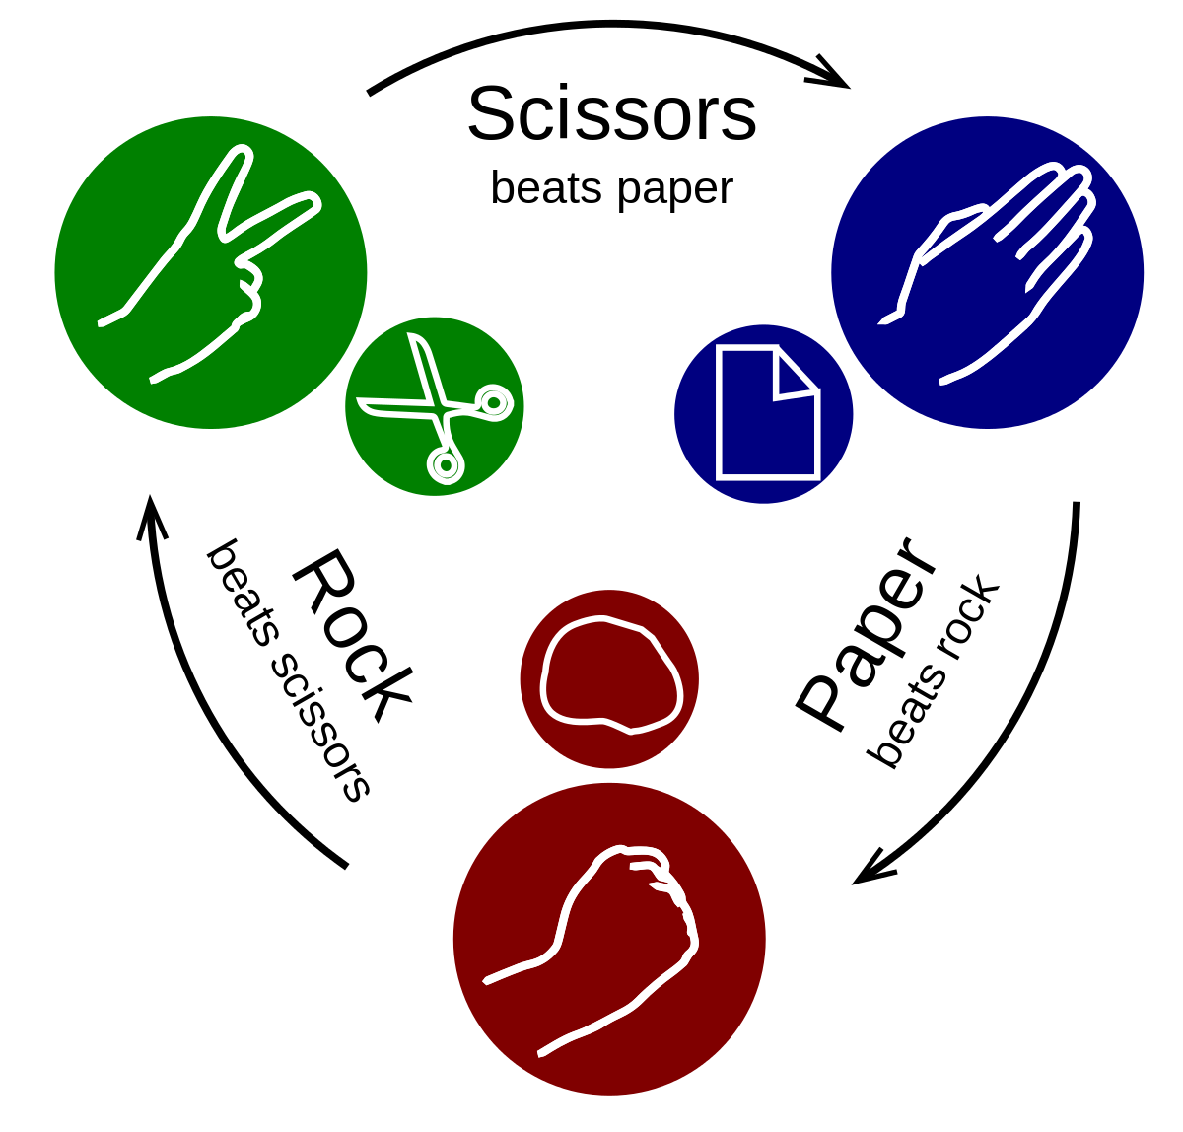
Rock, paper, scissors
Win-stay = if you win, you are more likely to stay with your current strategy
Lose-shift = if you lose, you are more likely to choose a different strategy
But what if you don’t know the rules of the game?

Slide 11
Rock, paper, scissors
Notes:
Even though you know you’ve won, you might not recognise the rule. Hence win-shift.

Slide 12
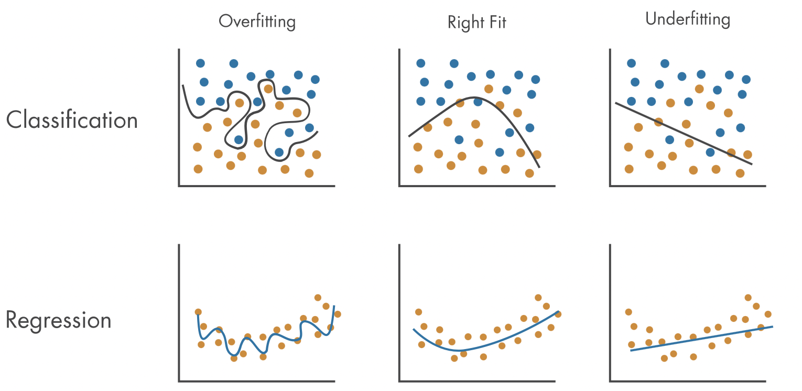
How many features do we actually have now?
38 features, 20 animals → 38 t tests???
Question: which feature(s) predict the treatment (Saline vs LSD) the best?
Solution: using a feature selection algorithm such as a logistic regression.
Feature selection using regressions
Regression/classification = fitting a line to data that describes it best.
The line might have many different shapes (e.g., linear regression = straight line, logistic regression = S-shaped curve)
Each type of line has parameters such as m (slope) and b (y-intercept) for linear regression: y = mx + b
Penalty. To prevent model overfitting, we can introduce a penalty for each

Slide 13

Selected features
Model = 70% accuracy

Slide 14
RESULTS

Slide 15
Number of achieved reversals
Number of trials to achieve reversal
and on day of reversal
Notes:
Stereotyped, using the same strategies,
With LSD getting rid of the necessity of multiple days

Slide 16
Number of achieved reversals
Number of trials to achieve reversal
and on day of reversal
Strategies
treatment
reversal
treatment
reversal
treatment
reversal
reversal + 3 days

Slide 17
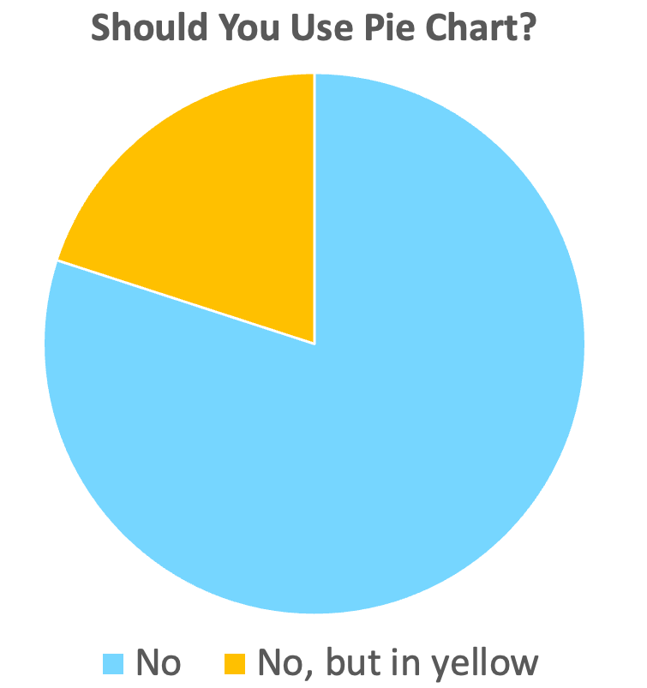

Slide 18
Up to reversal
On the day of reversal
3 days after reversal
treatment
reversal
treatment
reversal
treatment
reversal
reversal + 3 days
Saline
Saline
Saline
LSD
LSD
LSD

Slide 19
Timelines:
Up to reversal (toR)
treatment
reversal
On day of reversal (onR)
treatment
reversal
3 days post reversal (postR)
Proportion of persistent zeros:
- Higher: it may take longer to try something new, but once you do, you get it immediately
- Lower: more gradual learning process
treatment
reversal
reversal + 3 days
Notes:
Accuracy trends higher in LSD (toR), levels off onR and postR

Slide 20
Summary
Short-term flexibility (speed of learning) is enhanced by LSD
LSD animals achieve first reversal in fewer trials and have a trend towards higher accuracy than Saline animals.
There is no group difference in performance/accuracy on day of/after reversal
Strategy patterns in LSD vs Saline
Trend: LSD animals use less lose-stay and more win-stay up to reversing.
There are few differences in the strategy proportions on the day of reversing as well as 3 days after reversing.

Slide 22
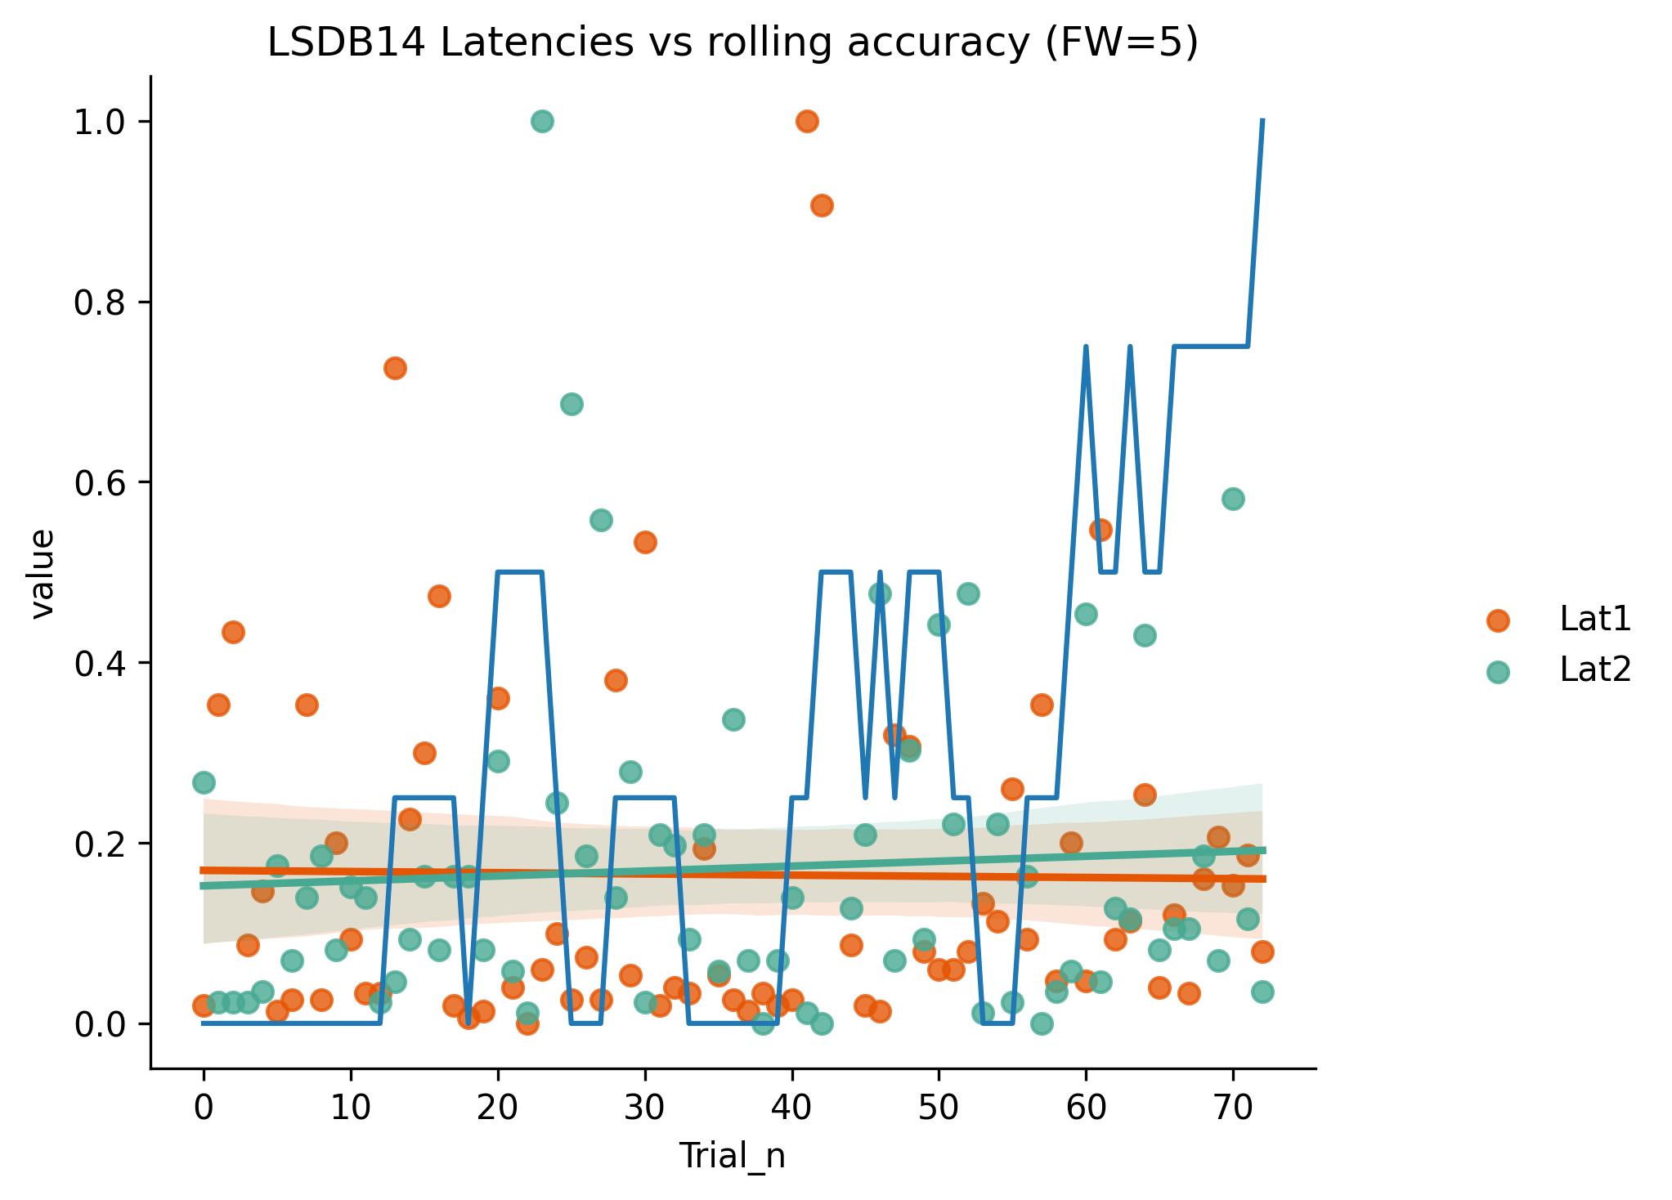
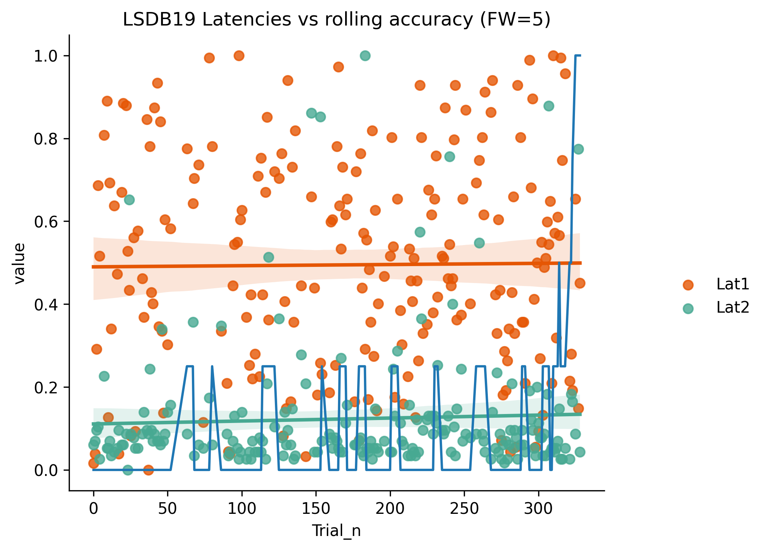
Does latency to lever press correlate with accuracy (up to reversal)?
Latencies: removed anything longer than 200ms (5-10 outliers per animal)
Y axis is MinMax scaled for each of the three measures plotted (Lat1, Lat2 and rolling accuracy)
Tried calculating rolling accuracy as 0+i/i, but this resulted in super small numbers especially for animals that took more trials to get to reversal. Floating window of 5 seemed to work the best.
Tried: correlating latencies with rolling accuracies, as well as seeing how those correlation predict overall accuracy.
Notes:
Average latencies across groups
Average latencies vs average accuracy

Slide 23
Behavioural flexibility
Psychedelics
Cognitive flexibility as a mechanism of action of psychedelics
Impairments in
Shown promise in
MDD, SUD, PTSD

Slide 24
Behavioural flexibility
Psychedelics
Cognitive flexibility as a mechanism of action of psychedelics
How do our results relate to this?
Psychedelics induce neuroplasticity that could be behind re-opening critical periods of learning.
Exploiting these by further interventions such as behavioural therapy or brain stimulation could help rewire detrimental behaviours in MDD, SUD, PTSD.
Notes:
Ability to maintain multiple concepts simultaneously and shift internal attention between them.
Ability to appropriately adapt to changing environment, switching between different behaviours depending on the context.
These are closely intertwined and sometimes used interchangeably.
Impairments in cognitive/behavioural flexibility are a feature of various mental health disorders, including major depression disorder and substance use disorder.
Improving cognitive flexibility to break out of patterns of detrimental behaviour is a plausible mechanism of action of psychedelic treatment
Upregulation of mTOR/BDNF within a few hours. Behavioural plasticity

Slide 25
Limitations
Small sample size for the number of comparisons that can be/have been made.
feature selection models can be used to ‘pre-select’ interesting features
Ceiling effect due to using a wildtype rat model.
Lack of long-term behavioural flexibility does not point to absence of neuroplasticity.
Control group split into two cohorts with slightly different conditions.
Next Steps
Running a larger cohort to mitigate some of the variability.
Looking at the temporal variable (reverse learning task 24h after treatment)
Mechanism of action (molecular targets), e.g. mTOR.
Accounting for performance in strategy proportions.
Notes:
If disease rat not only faster learning but also better performance overall. Close to population average.

Slide 26
Housekeeping: control samples from both cohorts?

Slide 27

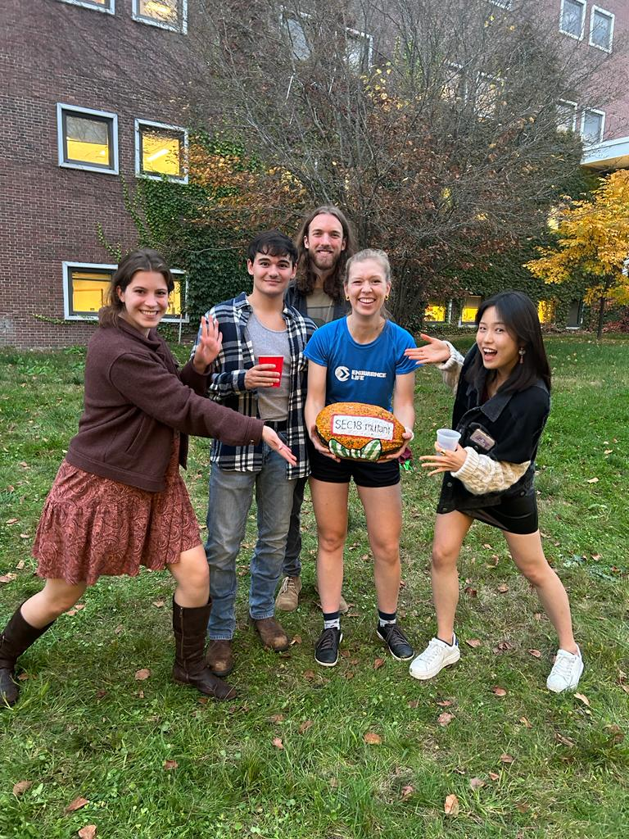
Acknowledgements
Doucette Lab
Dr Wilder Doucette
Lucas Dwiel
Moriah McGuier
Elise Bragg
Matthew Company
Ratfolk
IND
First years
Francesca Gilli
Mike Hoppa
All of you
SEC18 Pumpkin

